Slide 1
Unit 2 The Computer System hardware

Slide 2
Syllabus
Introduction
Central Processing Unit
Memory Unit
Instruction Format
Instruction Set
Instruction Cycle
Microprocessor
Interconnecting the Units of a Computer
Inside a Computer Cabinet

Slide 3
Introduction
Computer architecture refers to the structure and behavior of the computer. It includes the specifications of the components, for example, instruction format, instruction set and techniques for addressing memory, and how they connect to the other components.
Computer Organization focuses on the organizational structure. It deals with how the hardware components operate and the way they are connected to form the computer.
Computer Design focuses on the hardware to be used and the interconnection of parts.

Slide 4
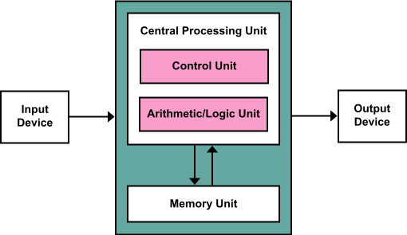
Architecture/Organization/Anatomy of computer/Interconnecting parts of Computer

Slide 5
Input Unit
It accepts data and instruction from the outside world.
It converts these data and instructions into computer understandable form binary form
It supplies the converted data and instruction to the computer system for further processing
Keyboard, Mouse , Scanner, Microphone etc.

Slide 6
Memory Unit
Primary Memory
When we enter the data into the computer using an input device, the entered information immediately gets saved in the memory unit of the Central Processing Unit (CPU).
Similarly, when the output of our command is processed by the CPU is saved in the memory unit before giving the output to the user.
Secondary Memory
It stores the raw data for future processing and processing information for future retrieval

Slide 7
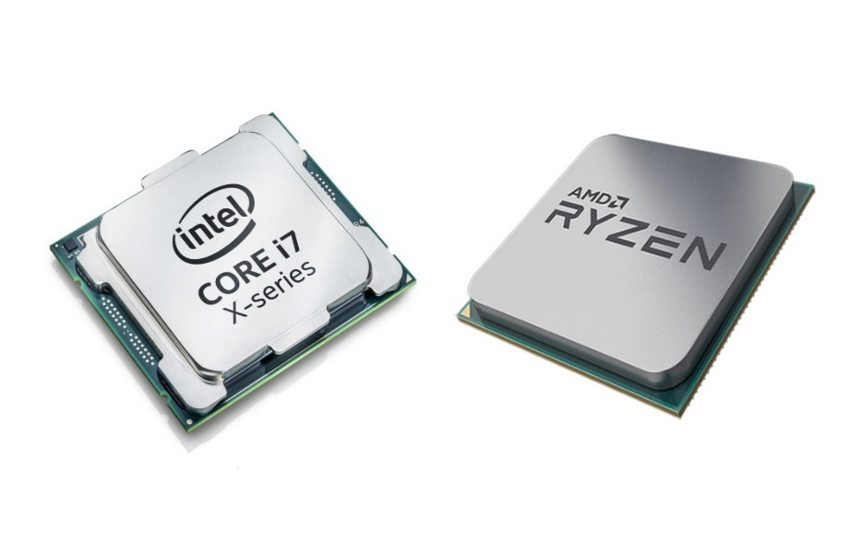
Central Processing Unit
CPU is component that is actually responsible for interpreting and executing most of the commands from the computer hardware and software and also controls the operation of all other components such as memory and input and output devices.
Function of CPU are :
Reads instructions from memory
Communicate with all peripherals using the system bus
It controls the sequence of instructions
Performs the computing tasks specified in program

Slide 8
Three components of CPU
Arithmetic and logical unit
Control Unit
Registers

Slide 9
Arithmetic & Logical Unit
As the name suggests, all the mathematical calculations or arithmetic operations(addition, subtraction, multiplication, Division) and Logical operations like AND,OR, NOT operations are performed in the Arithmetic and Logical Unit of the CPU.
It can also perform actions like a comparison of data and decision-making actions.

Slide 10
Control Unit
This is the core unit which manages the entire functioning of the computer device. It is one of the most essential components of the computer system.
The Control Unit collects the data entered using the input unit, leads it on for processing and once that is done, receives the output and presents it to the user. It can be said to the center of all processing actions taking place inside a computer device.
Basically, the instructions taken, interpretation of entered data, issuing signals to execute the data and then finally retrieving the data is all done in the Control Unit.

Slide 11
Registers
Registers are the high speed temporary storage locations in the CPU made from electronic devices such as transistors, flip flops etc.
Registers are primarily used to store data temporarily during the execution of program and are accessible to the user through instruction.
Registers that are required for instruction execution are:
Program Counter(PC): contains the address of the next instruction to be fetched
Instruction Register(IR): contains the instruction to be fetched next
Memory Address Registers(MAR): Contain the address of actual data to be fetched next
Memory Buffer Register(MBR): it contains actual data to be fetched next
Accumulator(ACC): An Accumulator is general purpose register used for storing temporary results and results produced by ALU

Slide 12
Output Unit
Accept the result produce by the computer which is in electric binary signals.
It then converts the result into human readable form.
Finally, it supplies the converted results to the user
Output devices: Speakers, Monitor, Printer, Plotters etc

Slide 13
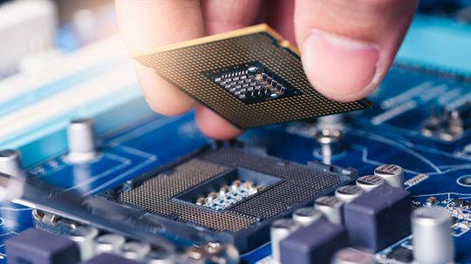
Microprocessor
Microprocessor is multipurpose, programmable, clock driven, register based semiconductor device consisting of electronic logic circuit manufactured using either LSI or VLSI technique
Integrated Single Chip
Clock Speed
It represents how many cycles per second processor can execute. Measured in GHz
Word Length
Word length of the processor in a computer refers to the maximum number of bits it can take as input.
It is number of bits processed by a computer CPU in single pass
8,16,32,64 bits and so on.

Slide 14
Instruction Format
Instruction format in computer architecture refer to the way instructions are encoded and represented in Machine Language to be executed in ALU of CPU.
The instruction format grouped partitioned in multiple fields. Each field of the machine provides specific information
Mode : it mode of addressing of operand, that specifies whether the operand hold actual value stored in memory or address at which actual data is stored
Operation Code: it holds the operation to be performed on operand like add, subtract, multiply, shift, complement etc
Operand: it can be actual data or address of data on memory or address of address of actual data
Mode | Operation Code | Operand 1 | Operand 2 | Operand 3
3 address instruction format

Slide 15
Instruction Format
Mode | Operation Code | Operand 1 | Operand 2
2 address instruction format
Mode | Operation Code | Operand
1 address instruction format

Slide 16
Instruction Format
Evaluate C=A+B in 3 address instruction assembly language notation
ADD C,A,B
Evaluate C=A+B in 2 address instruction
MOV C,A
ADD C,B
Evaluate C=A+B in 1 address instruction
LOAD A
ADD B
STORE C

Slide 17
Instruction Format
X = (A+B)*(C+D)
Evaluate X=(A+B)*(C+D) in 3 address instruction in assembly language notation
ADD R1,A,B
ADD R2,C,D
MUL X,R1,R2
Evaluate X=(A+B)*(C+D) in 2 address instruction in assembly language notation
MOV R1,A
ADD R1,B
MOV R2,C
ADD R2,D
MOV X,R1
MUL X,R2
Evaluate X=(A+B)*(C+D) in 1 address instruction in assembly language notation
LOAD A
ADD B
STORE T
LOAD C
ADD D
MUL T
STORE X

Slide 18
Instruction Set
It is the collection of machine language instructions that a particular processor understands and executes. Assembly language mnemonics are used to represents the instruction
It is machine dependent . i.e. different processor have different instruction sets
Following types of instructions: 1. Arithmetic Instructions: ADD, SUB, MUL, DIV
2. Logical Instructions: >, <, =
3. Data Transfer Instruction
MOV − Used to copy the byte or word from the provided source to the provided destination.
PPUSH − Used to put a word at the top of the stack.
POP − Used to get a word from the top of the stack to the provided location.
PUSHA − Used to put all the registers into the stack.
POPA − Used to get words from the stack to all registers.
XCHG − Used to exchange the data from two locations.
XLAT − Used to translate a byte in AL using a table in the memory.

Slide 19
Instruction Set
4. I/O instruction:
IN − Used to read a byte or word from the provided port to the accumulator.
OUT − Used to send out a byte or word from the accumulator to the provided port.
5. Control Instruction
The instruction used to change the sequence of instruction of a program are control instruction.
LOOP − Used to loop a group of instructions until the condition satisfies.
INT − Used to interrupt the program during execution and calling service specified.

Slide 20
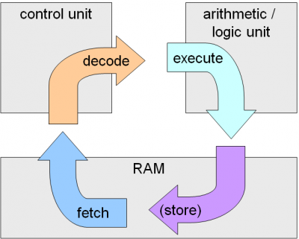
Instruction Cycle
The instruction cycle (also known as the Fetch–Decode–Execute cycle or the fetch-execute cycle) is the basic operational process of a computer system.
The time taken for the execution of an instruction is known as Instruction Cycle
The typical instruction cycle consists of the following stages:
Fetch: The CPU retrieves the next instruction from memory. The program counter (PC) holds the address of the next instruction to be fetched.
Decode: The fetched instruction is decoded, which means the CPU determines what operation the instruction is specifying and what operands are involved.
Execute: The CPU performs the operation or instruction, manipulating data according to the decoded instruction.
Store (optional): If the instruction involves storing the result of the operation back to memory or a register, this step is performed.

Slide 21
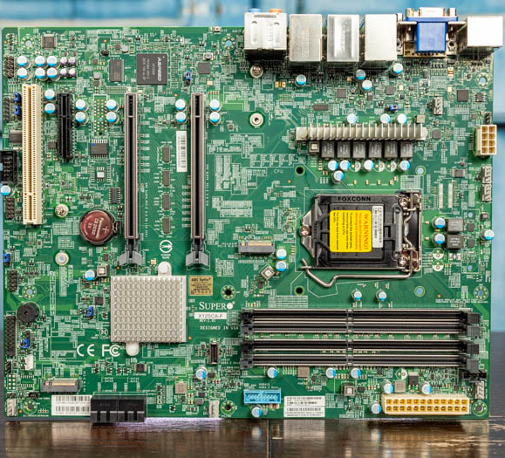
Inside the Computer Cabinet
PSU
Motherboard
Memory units
Optical Devices
The motherboard is the computer's main circuit board. It's a thin plate printed circuit board that holds the CPU, memory, connectors for the hard drive and optical drives, expansion cards to control the video and audio, and connections to your computer's ports (such as USB ports). The motherboard connects directly or indirectly to every part of the computer.

Slide 22
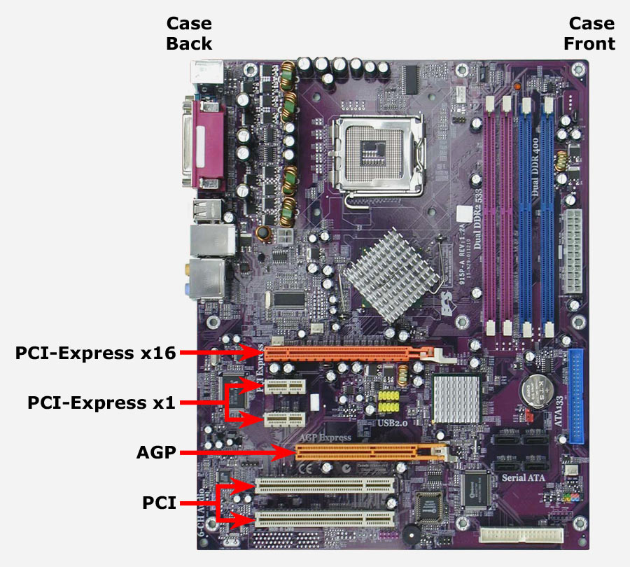
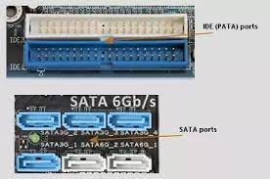
Inside the Computer Cabinet

Slide 23
END

